Slide 1
A Low-Power Dataflow-Optimized Datapath for Mixed Neural Acceleration
JAYASRI JAWAHAR SRIPATHY
1RV23EC059
KRISHNA SAINI
1RV23EC069
GURUKIRAN B H 1RV24EC404
Experiential Learning

Slide 2
Introduction
Modern AI applications such as image recognition, speech processing, and video analytics use deep neural networks that perform a large number of multiply–accumulate (MAC) operations during inference. To run these networks efficiently, many hardware accelerators have been developed.
Types of AI Accelerators in Practice
CNN accelerators are designed for highly parallel convolution operations.
RNN/LSTM accelerators are designed for sequential and temporal processing.
Fixed-precision accelerators execute all operations at a fixed bit-width.
Approximate or device-level adaptive accelerators reduce power but lack architectural flexibility.
These accelerators work well for specific tasks but are not well suited for dynamic edge workloads.
Key Limitations/Literature Gaps in Existing Accelerators
Fixed Precision and Power Usage
Most accelerators always use full precision, even when lower precision is sufficient. This leads to unnecessary power consumption, especially on edge devices.
Single-Mode Operation (CNN or RNN only)
Many accelerators support either CNN-style parallel processing or RNN-style sequential processing, but not both. As a result, edge systems often need multiple accelerators, increasing silicon area, leakage power, and system complexity.

Slide 3
Literature Review
Paper Name | Concept of Paper | Literature Gap/ Differences
[1]Armeniakos et al., 2022 G. Armeniakos, G. Zervakis, D. Soudris, and J. Henkel, “Hardware Approximate Techniques for Deep Neural Network Accelerators: A Survey,”IEEE Transactions on Circuits and Systems I, pp. 1–17, 2022. | Comprehensive review of approximate adders, multipliers, truncated MACs. Shows ML workloads (CNN, RNN, LSTM) tolerate arithmetic errors well. Discusses bit-width reduction, carry-skip, LSB truncation, low-precision multipliers. Reports major energy savings (30–70%) with minimal accuracy loss | Works only on one MAC unit → no multi-stream, multi-core array. No stream/cluster-level control. Does not include parallel vs sequential mode. No processor-driven runtime orchestration.
[2] Li et al., 2024 (Approximate Multi-Granularity MAC) W. Li, H. Wu, J. Chen, and Y. Luo,“Design of Approximate Multi-Granularity Multiply-Accumulate Unit,” in Proceedings of the ACM Great Lakes Symposium on VLSI (GLSVLSI), pp. 367–372, 2024. | Implements approximate MACs using Reconfigurable FETs. Demonstrates significant power savings (~70%) with tolerable ML accuracy drop. Focused on CNN inference acceleration. Shows approximate computing is viable for DNN workloads. | Only applies approximation at device-level, not architecture-level. CNN-only; no support for sequential workloads (RNN/LSTM). No stream-level adaptivity or multi-core configuration.
[3] Saravanan et al., 2023 (Reconfigurable FET Approx. Accelerator) R. Saravanan, S. Bavikadi, S. Rai, A. Kumar, and S. M. P. Dinakarrao, “Reconfigurable FET Approximate-Computing-Based Accelerator for Deep Learning Applications,” IEEE Transactions on Electron Devices, vol. 70, no. 7, pp. 3237–3244, 2023. | Implements approximate MACs using Reconfigurable FETs. Demonstrates significant power savings (~70%) with tolerable ML accuracy drop. Focused on CNN inference acceleration. Shows approximate computing is viable for DNN workloads. | Only applies approximation at device-level, not architecture-level. CNN-only; no support for sequential workloads (RNN/LSTM). No stream-level adaptivity or multi-core configuration.

Slide 4
Literature Review
Paper Name | Concept of Paper | Literature Gap/ Differences
[4]Adaptive approximate computing in arithmetic datapaths Mazahir, S., Hasan, O., & Shafique, M. (2018). Adaptive approximate computing in arithmetic datapaths. IEEE Design & Test, 35(4), 65-74. | Uses complementary approximate modules (GeAr/CGeAr adders) in datapaths for error self-cancellation​ Demonstrates adaptive datapath with minimal overhead | Focuses on error self-cancellation via complementary modules, not core_enable masking​ Lacks quality_mode precision/truncation control in arithmetic datapaths​ No explicit CNN/RNN parallel-sequential workload modes
[5] Chen et al., 2017 (Eyeriss – CNN Accelerator) Y.-H. Chen, T. Krishna, J. Emer, and V. Sze, “Eyeriss: An Energy-Efficient Reconfigurable Accelerator for Deep Convolutional Neural Networks,”IEEE Journal of Solid-State Circuits (JSSC), vol. 52, no. 1, pp. 127–138, 2017. | Implements a spatially optimized CNN-specific accelerator. Uses data reuse and dataflow optimization to reduce memory access energy. Demonstrates high energy efficiency for CNN inference workloads. | CNN-only architecture; no support for sequential workloads (RNN/LSTM). MAC array tightly coupled to convolution dataflow, limiting reuse. Requires separate hardware for temporal or recurrent models.
[6] Han et al., 2017 (ESE – RNN Accelerator) S. Han, X. Liu, H. Mao, et al., “ESE: Efficient Speech Recognition Engine with Sparse LSTM on FPGA,” Proceedings of the International Symposium on Computer Architecture (ISCA), 2017. | Implements a specialized accelerator for RNN/LSTM workloads. Optimized for sequential computation and temporal reuse.Shows approximate computing is viable for DNN workloads. Well-suited for speech recognition and sequence modeling. | RNN-only architecture; cannot execute CNN workloads.CNN-only; no support for sequential workloads (RNN/LSTM). Requires a separate CNN accelerator for vision-based pipelines. No unified execution model for mixed CNN–RNN workloads.

Slide 5
Literature Gaps
1. Existing HDL-based accelerators are generally optimized for either CNN or RNN workloads separately, with limited support for unified hybrid execution.
2. Many accelerator architectures rely on static hardware configurations and require manual resource allocation and mode selection.
3. Current designs provide limited support for model-aware runtime adaptation based on workload complexity and execution requirements.
4. Efficient integration of parallel CNN execution and sequential RNN/LSTM execution within a single scalable framework remains limited.

Slide 6
Motivation
Background
In our earlier project on violence detection from video, we observed that the AI model relied on both image-based spatial features (CNN) and time-dependent motion patterns (RNN/LSTM). Running these computations on general-purpose processors caused significant delays and high-power usage on edge devices such as cameras and Raspberry Pi.
Why Hardware Helps:
Mixed AI workloads involving CNN and RNN require a large number of MAC operations, making software-only execution inefficient and power-hungry for edge devices.
This work applies HDL to apply techniques—such as precision adaptivity, selective core activation, and reconfigurable datapaths—to build a hardware-level adaptive accelerator. The proposed architecture supports both parallel CNN-style and sequential RNN-style execution on the same compute fabric, while dynamically adjusting precision based on workload needs.

Slide 7
Problem Statement
Current neural accelerators lack a unified, runtime-adaptive architecture that seamlessly adjusts arithmetic precision and computational mode for both CNN and RNN workloads, resulting in sub-optimal power-performance and reduced efficiency.

Slide 8
Objectives
To design a model-aware accelerator that dynamically adapts hardware configuration based on input model complexity.
To enable efficient parallel processing using multi-stream execution with dynamic core allocation per stream.
To support hybrid execution by integrating both parallel CNN processing and sequential RNN/LSTM processing within a single architecture.
To implement a runtime configuration mechanism that optimizes performance and power by selecting appropriate execution modes and resource usage.

Slide 9

Software Stack
Python - Main programming language for project integration
PyTorch - Used to build and train the CNN and RNN models
Verilator - Converts SystemVerilog RTL into C++ simulation models
Windows Subsystem for Linux (WSL) -Provides a Linux environment for running system verilog-generated executables
NumPy - Used for numerical computations and matrix operations

Slide 10
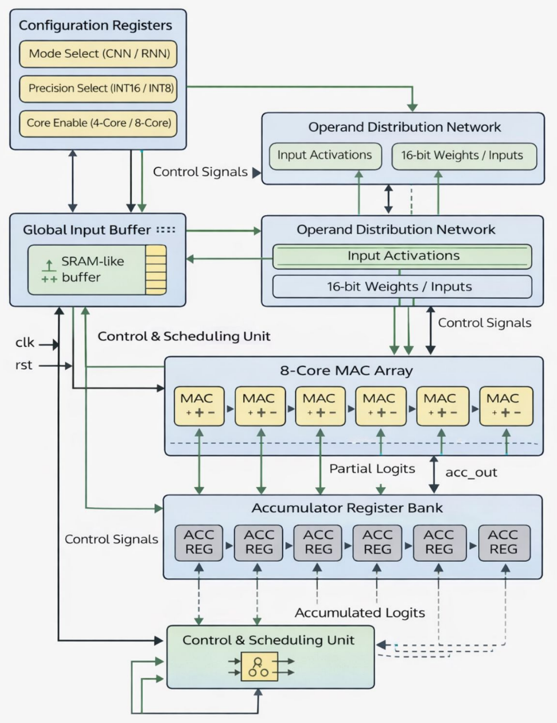
Accelerator Architecture

Slide 11
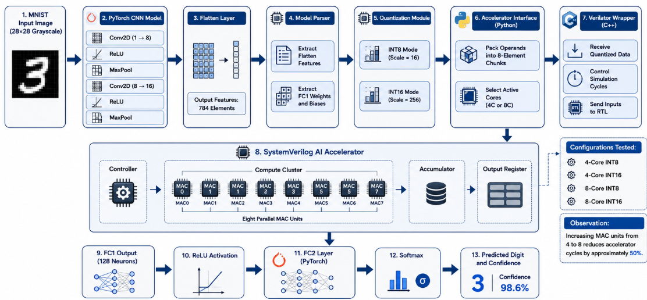
CNN-Hardware Inference Pipline

Slide 12
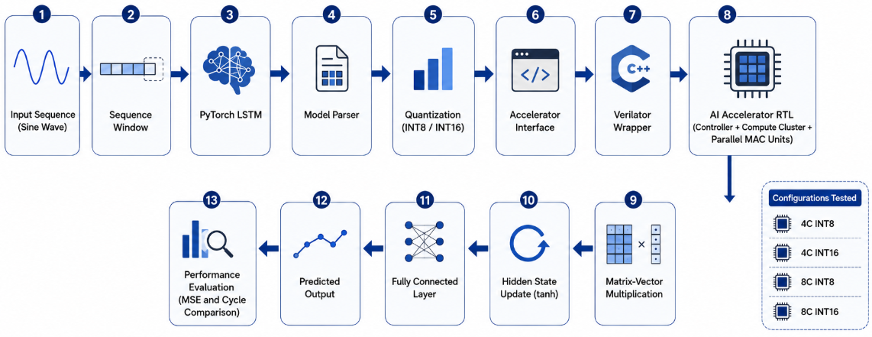
RNN-Hardware Inference Pipeline

Slide 13
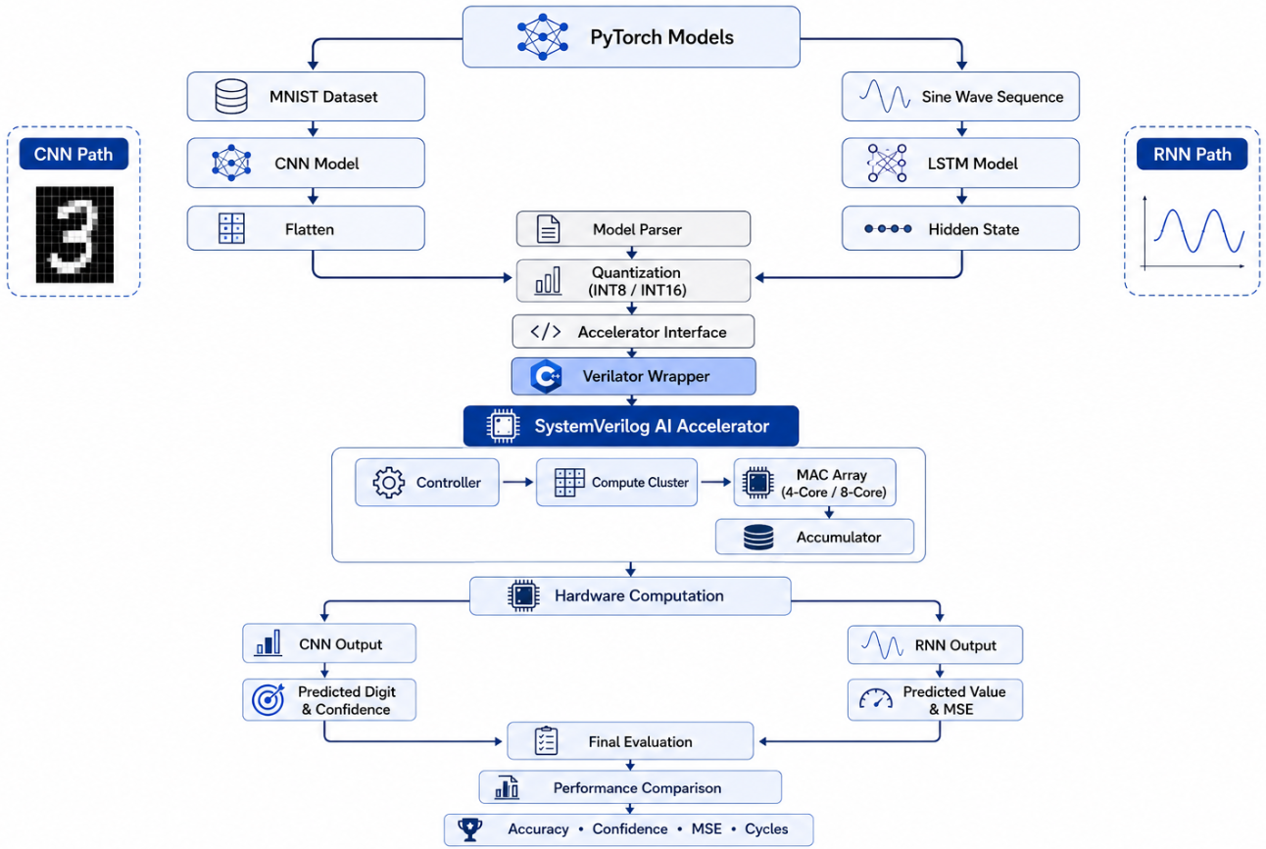

Slide 14
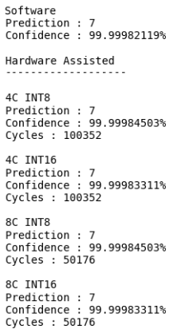
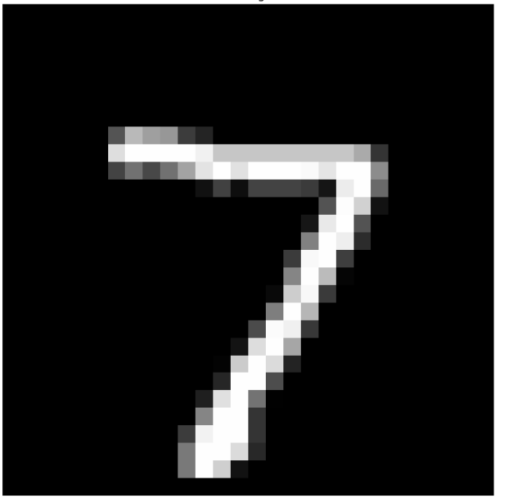
CNN Prediction Software vs Hardware

Slide 15
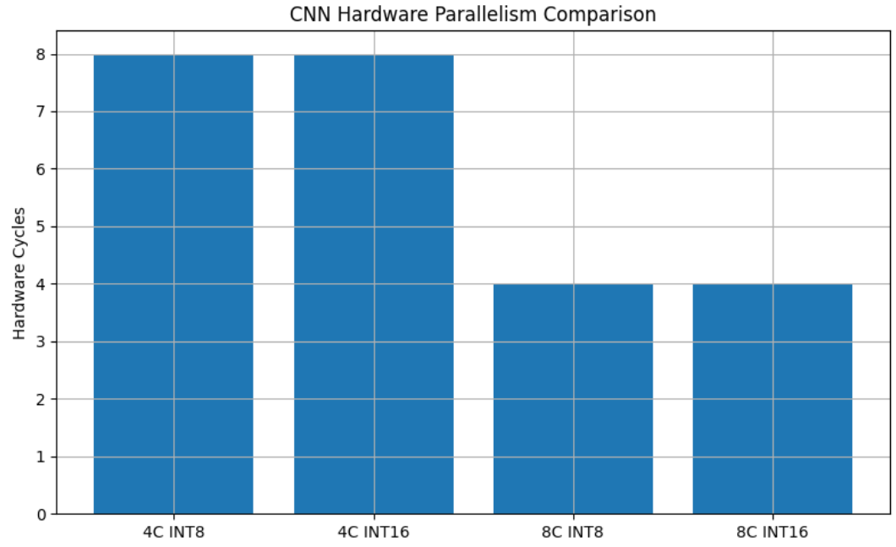
CNN Core and INT-Precision Tradeoff

Slide 16
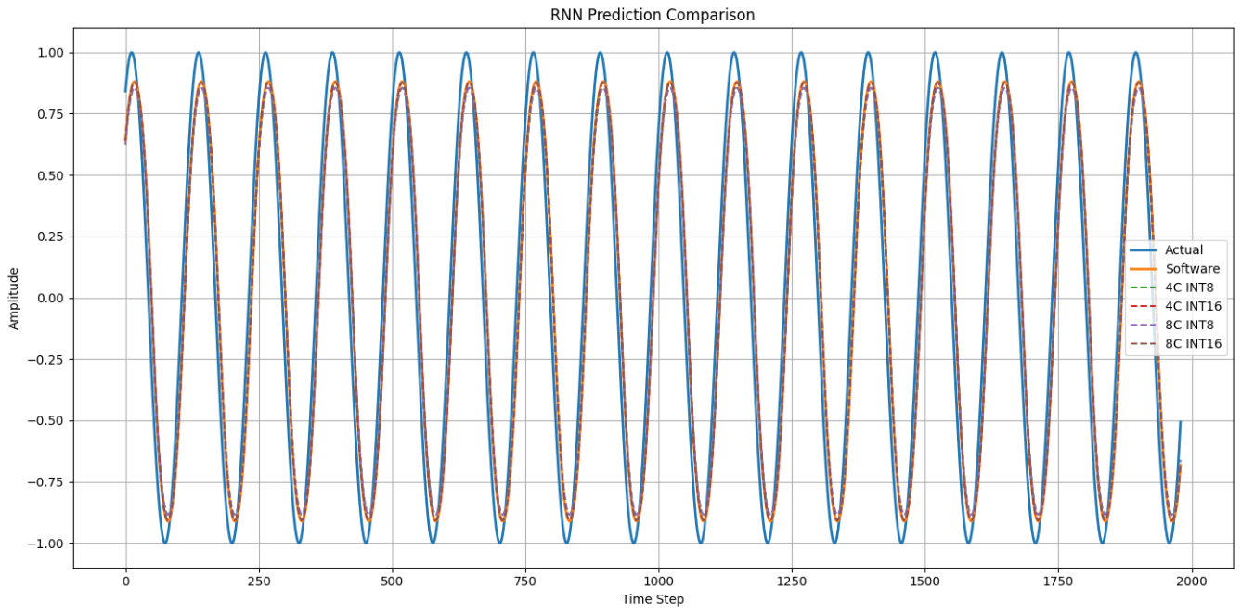
RNN Prediction Software vs Hardware

Slide 17
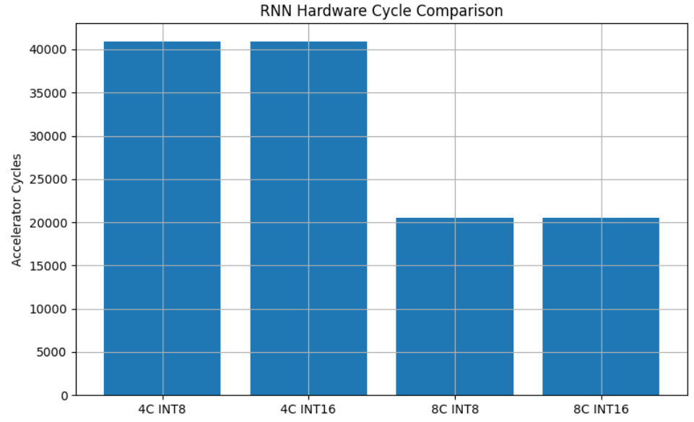
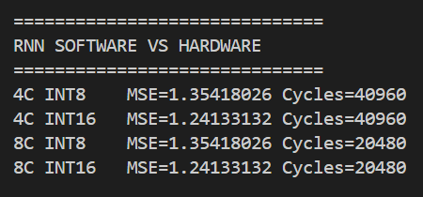
RNN Core and INT – Precision Tradeoff

Slide 18
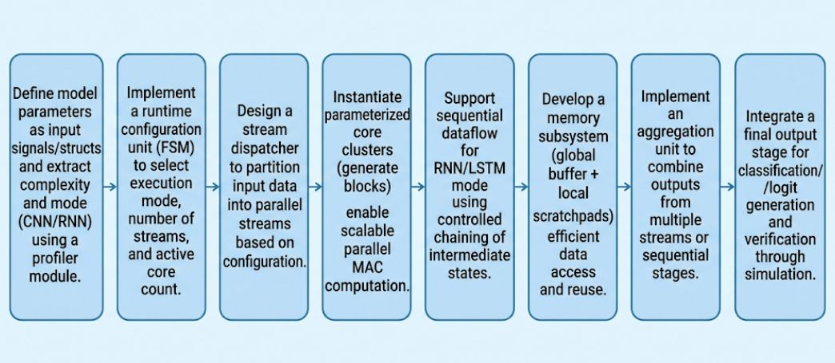
Methodology

Slide 19



